Slide 1

Notes:
[Max] … we are the creators of RM

Slide 2
We have invented an interaction.
Notes:
[Alex] Let’s us give you the core idea in two sentences

Slide 3
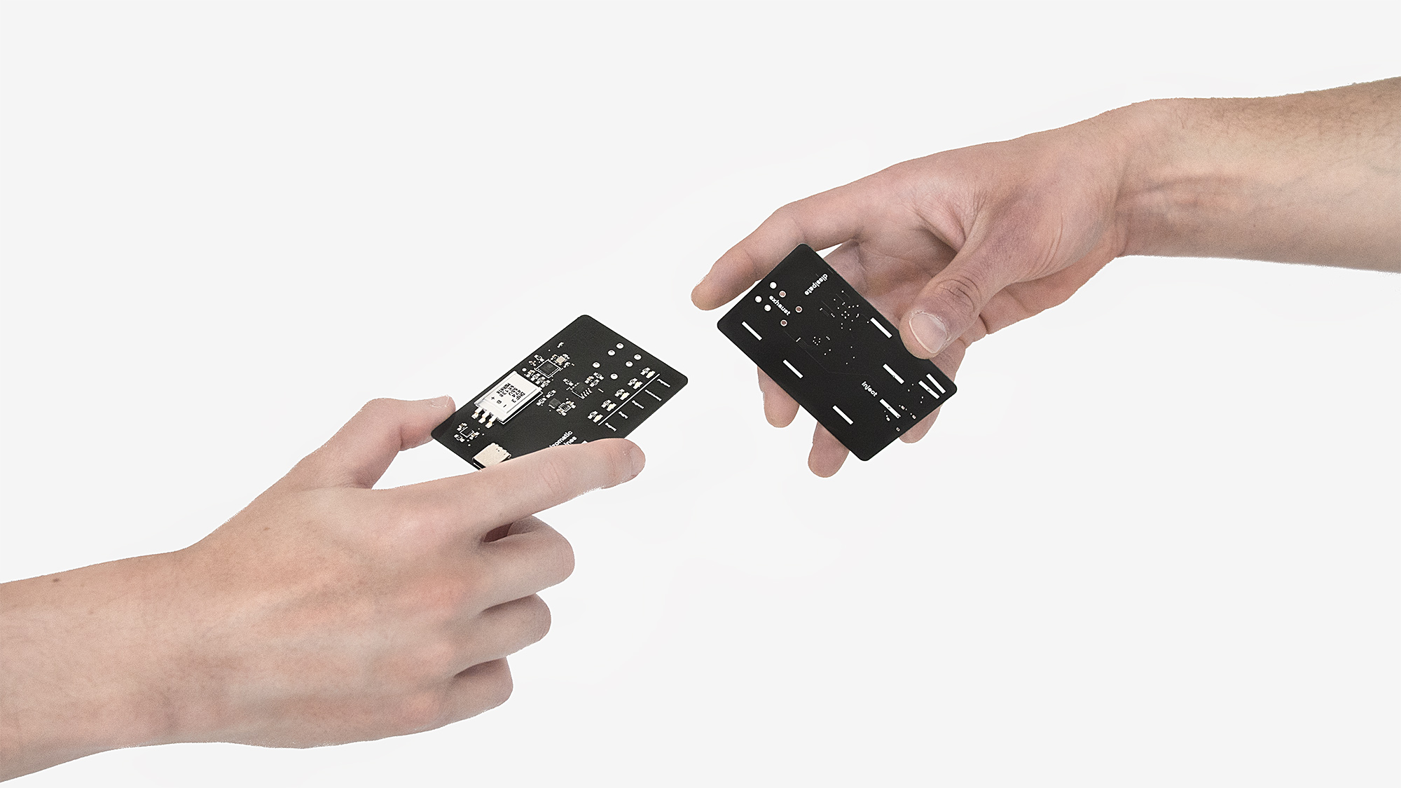
Notes:
[Max] Social networks are boring
Until now there is no real life application for blockchain
So we wanted to create a physical bridge to the internet.
But with latest hi-tech and cutting edge design.
That‘s where rhizm is situated.

Slide 4
From bare metal to the cloud.
A full stack high end design solution.
Notes:
[Alex]
The device itself is a custom designed PCB with the latest technology available on the market.
* Custom magnet connector
* Secure & encrypted
* WiFi
* Supercapacitor Power Supply
* USB-C
* IoT
Blockchain
RoHS

Slide 5

Notes:
[Max]
Talk about complexity

Slide 6
Witness the first public intercourse:
www.rhizomaticmachines.com
Notes:
[Alex]
Call audience for going on website

Slide 7
Let’s talk business for a moment.
Notes:
[Max]

Slide 8
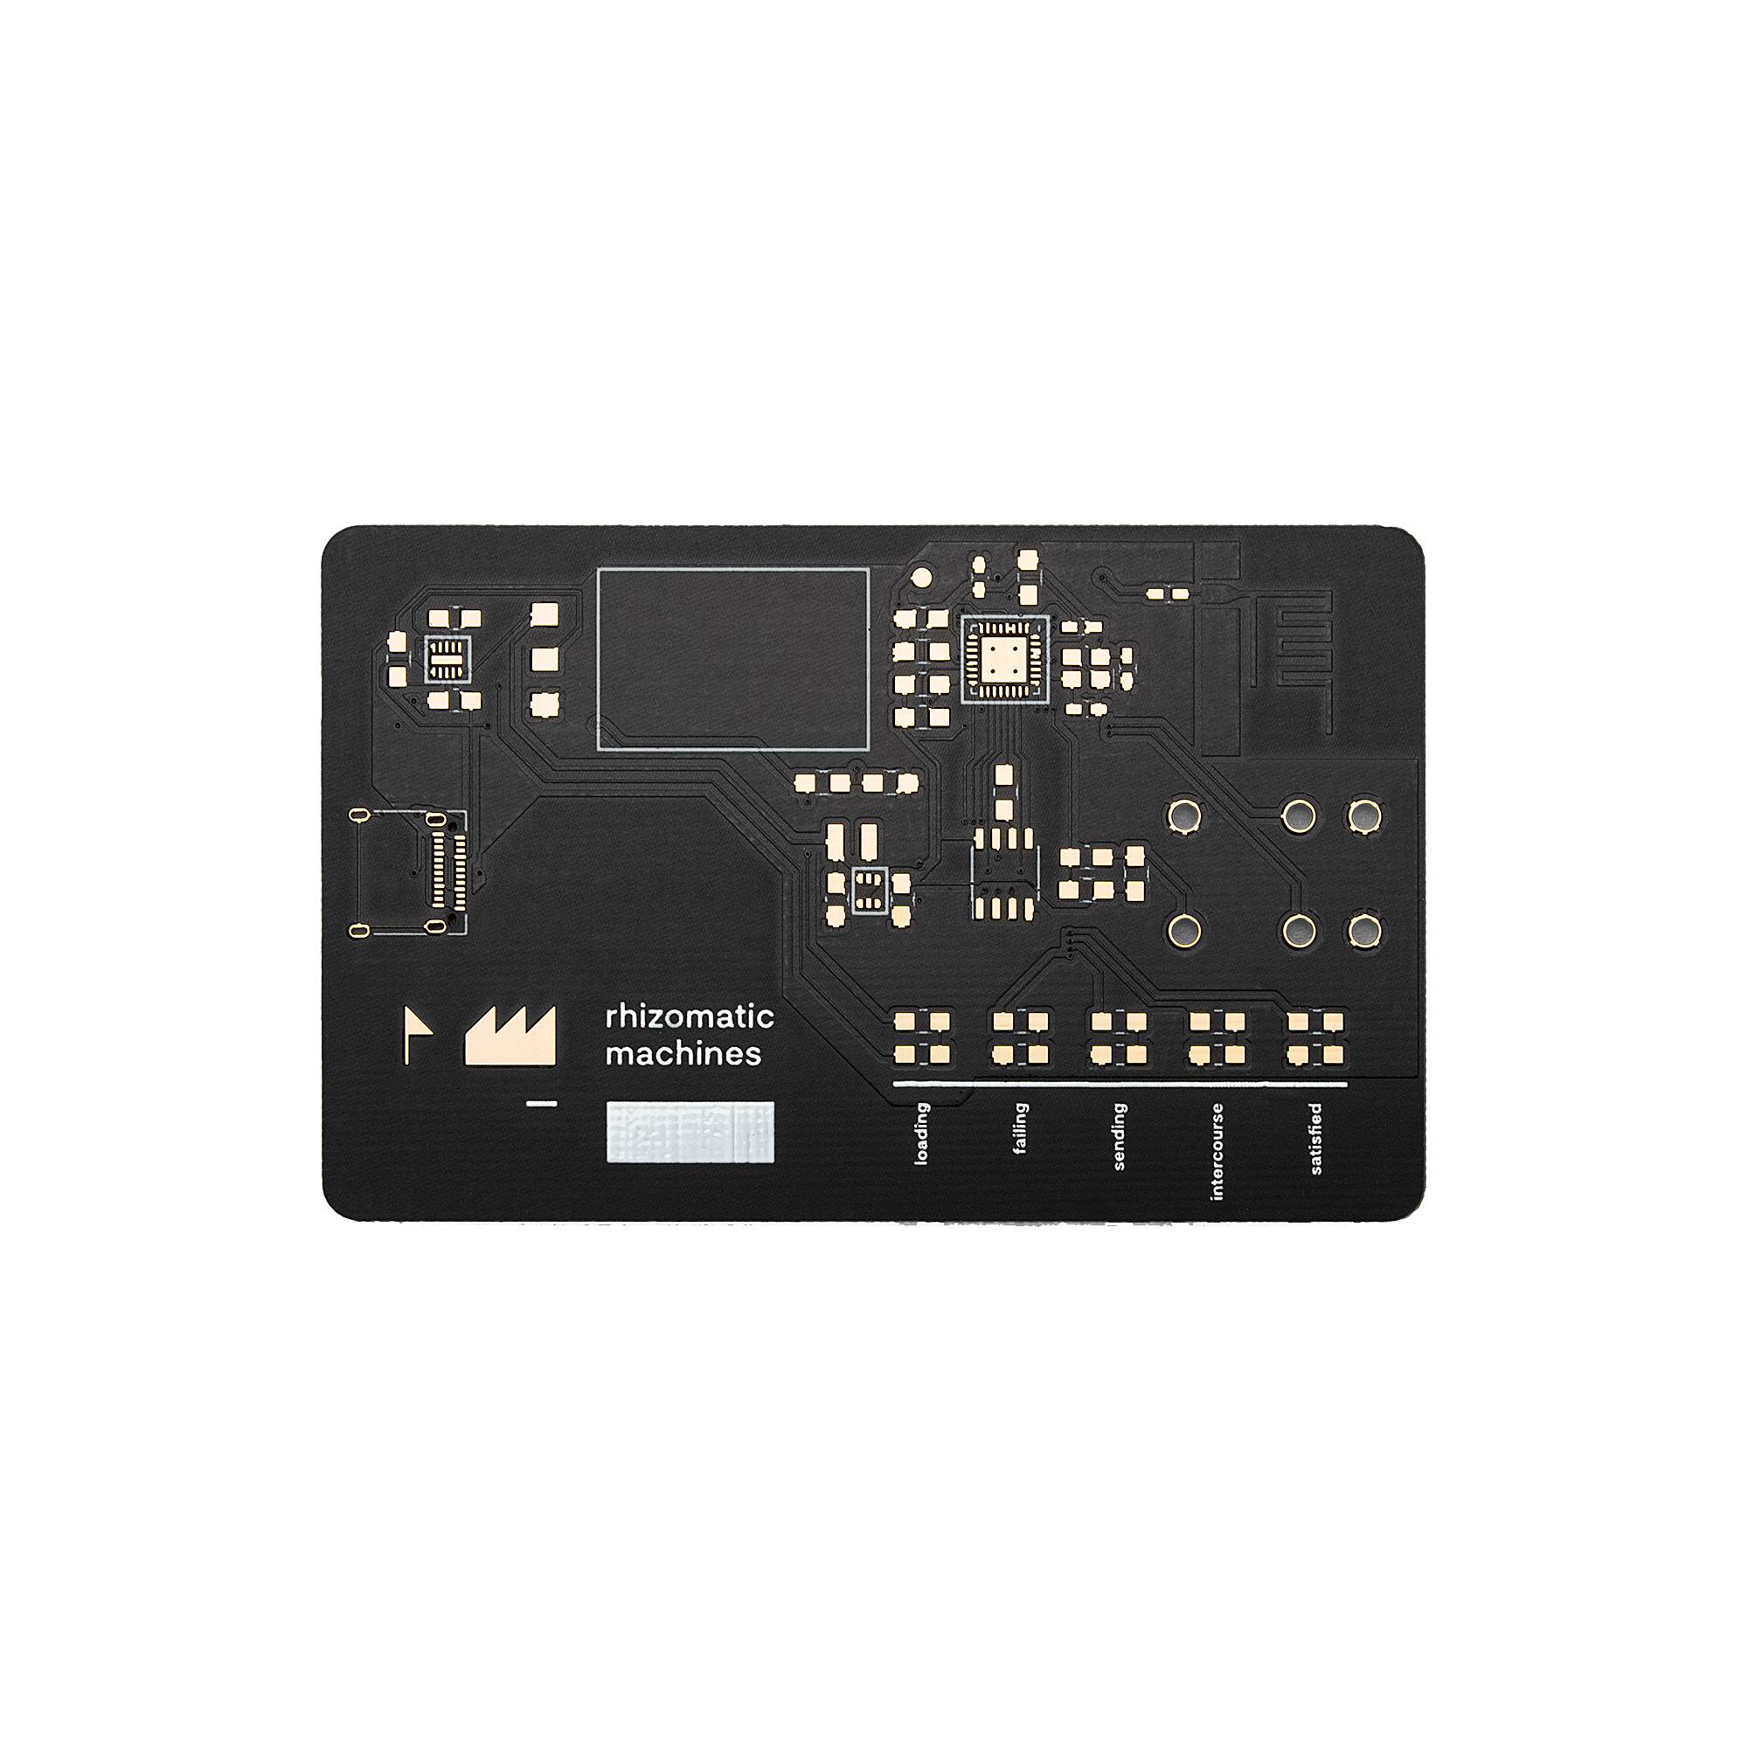
Notes:
[Max]
Rev 3
Tech talk
High end:
Supercap
Magnets
Wifi
Credit card size

Slide 9
Social sandbox.
Notes:
[Alex]
Sandbox – This is what we do.
Explain possible use cases:
Collectible / Game
Offline interaction secure data transfer
Open source social network (you have to keep track of the hashes)
Social tiers for very well connected people (like in Black Mirror)
Everything involving mesh network connections

Slide 10
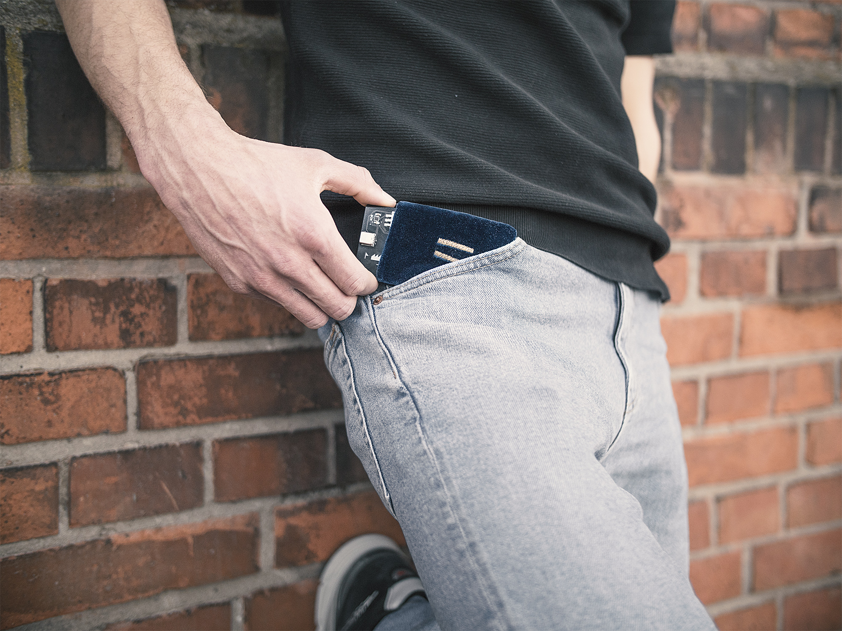
Sleeve and
cable included.
Notes:
[Max]
This comes with the product.
Eco system
Pricing model

Slide 11
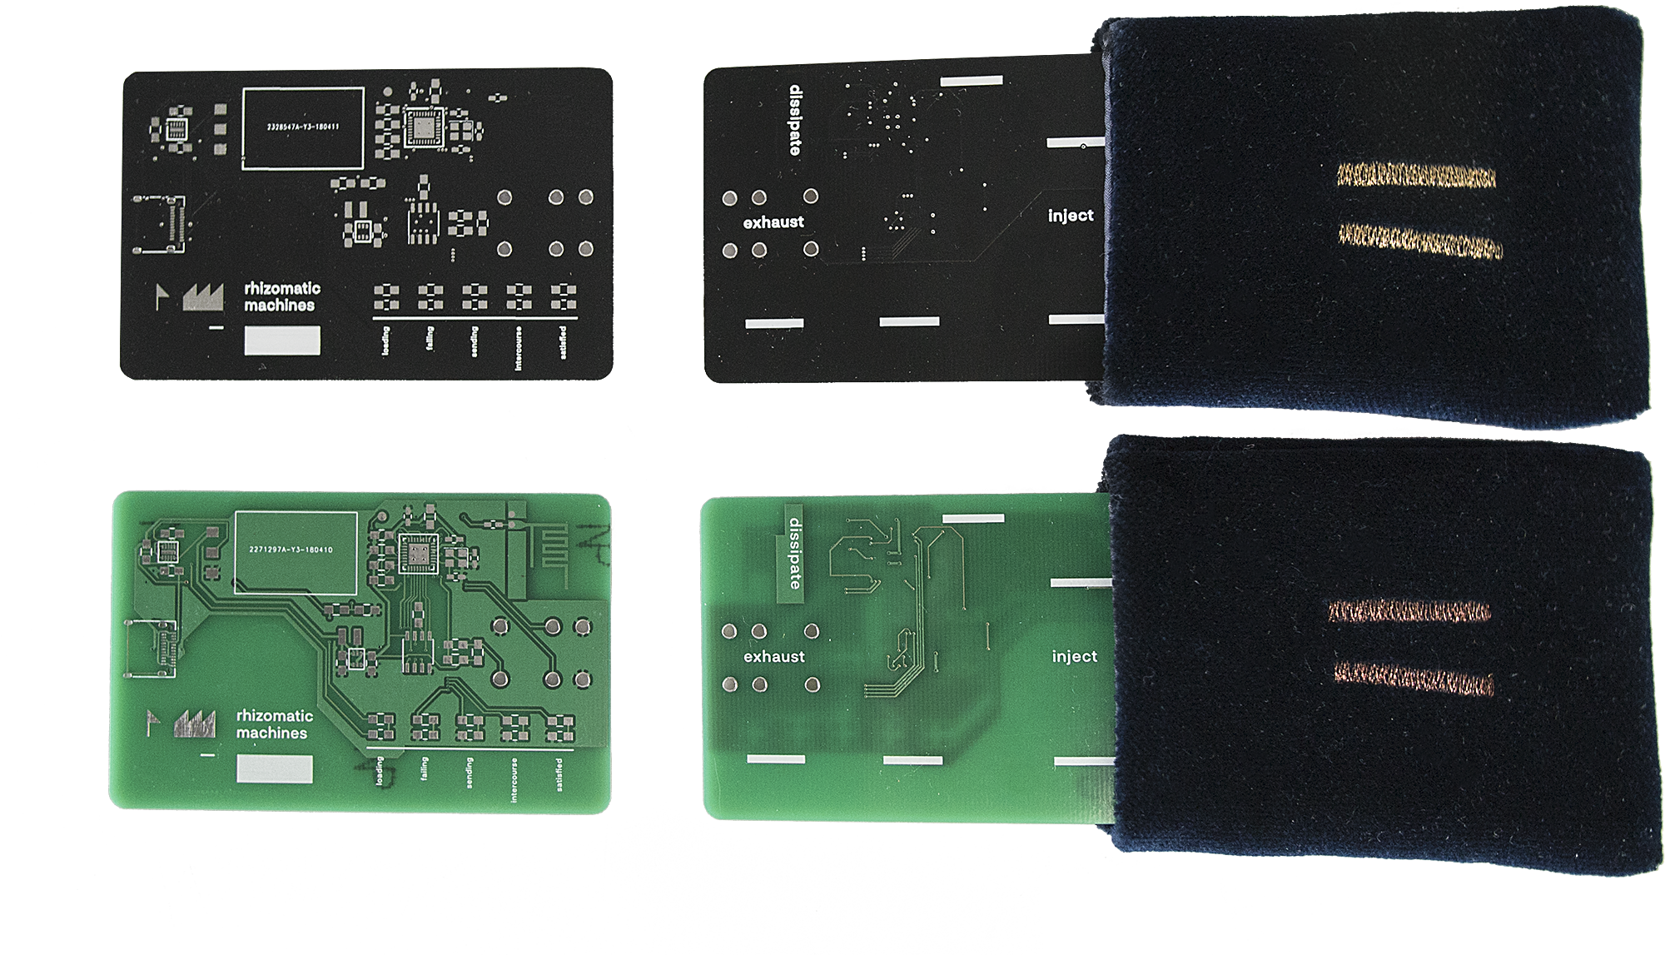
Notes:
[Max]
Different colors

Slide 12
W E F U T U R E
Notes:
[Alex]
Milestone reached
Small batch production
Evaluation
Publicity
Mass Production

Slide 13
Thank you.
Notes:
[Max]
Thank our friends and supervisors
And all the nice werkstattleiters

